Slide 1


SIMPUTER Delivered By: SHANTANU P. POTDAR Department of Computer Engineering Bajaj Institute of Technology, Wardha. Under Supervision of: Miss. U. N. Pote Assistant Professor Computer Engineering Department, BIT, Wardha

Slide 2
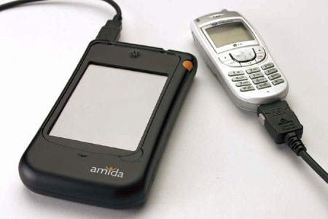
INDEX
Introduction
Objectives
Literature Review
System architecture
Features/Advantages/Disadvantages
Comparison
Applications
Conclusion
References

Slide 3
INTRODUTION
A Simputer is a multilingual, mass access, low cost,
portable alternative to PC’s by which the benefits of IT
can reach the common man.
First released on 21 April 2001.
Dr. Swami Manohar was leader.(Group of seven scientist)
It has a special role in the third world war because it is ensures that illiteracy is no longer barrier in handling
a computer.

Slide 4
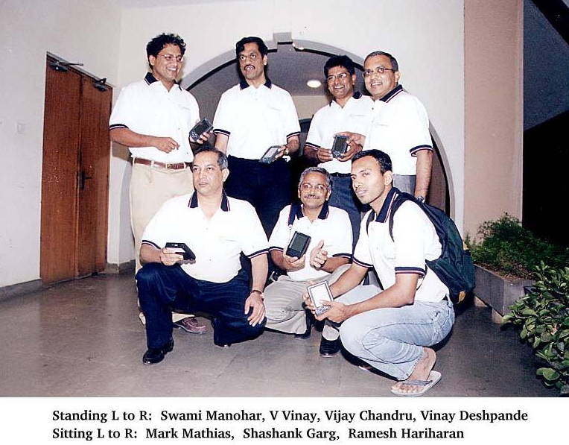

Slide 5
HISTORY
The invention of simputer was announced in 2001. ✓
Simputer inventors professors at Bangalores Indian Institute of Science formed PicoPeta Simputers Pvt. Ltd. ✓
It uses Microsoft's Windows XP operating system.
Other computers are weighed several kilos, but Simputer fit snugly your shirt pocket and your wallet ✓
For the first time in history, a computer was designed in the third world war, to be used by people in all worlds. ✓
We have now Amida Semputer.

Slide 6
OBJECTIVE
Even the poorest of the poor will pay for the service ,if that service improves in some way their quality of life.
Several corporates are now addressing rural markets and they have the need for information and communication infrastructure in remote location.

Slide 7
LITERATURE REVIEW
Sr. no. | Topics | Information get from
1. | Introduction and History | https://en.wikipedia.org/wiki/Simputer
2. | System architecture/ Features/Advantages/ Disadvantages/ Applications | http://www.123seminarsonly.com/Seminar-Reports/005/Simputer.html
3. | Comparison | https://cupdf.com/document/simputer technology ppt.html?page=5

Slide 8
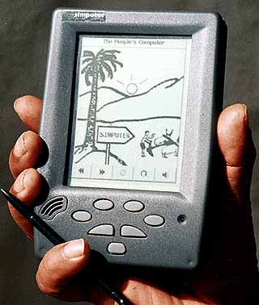
SYSTEM ARCHITECTURE
HARDWARE
CPU 32 bit.
64MB of DRAM.
24MB flash for permanent storage.
Display I/F 32 x 240 monochrome LCD display panel
INTERFACES
Touch panel overlay on LCD Display used with a plastic stylus (pen).
Speaker, Microphone, MIC jacks, Smart card connector.
RJ-II telephone jack .
USB connector.
DIMENSIONS
Approximately 8cm x 13cm x 2cm .
Power supply 3AAA sized batteries.

Slide 9
System Software
Linux kernel(2.4.18 kernel as of july2005)
Alchemy windows manager
Application Software
Internet Access
Music
PIM Applications

Slide 10
FEATURES
INTERNET
Internet Browser ,Email ,Headlines
PLAY
MP3 Music Player ,Photo Album ,Games , E-LibraryEducation
WORK
Khatha ,Paper ,Notebook ,Bhasha Notebook ,Voice Recorder
TOOLS
1. Calendar
2. Panchanga
3. Smart Card
4. Health Manager
5. Conversion Calculator
6. World Clock
7. Stop Clock
8. Address book
9. Calculator
10. Network

Slide 11
APPLICATION
The architecture of the Simputer integrates various devices such as Smart Card reader, a Modem, a Touch Screen, a Multi-lingual Texto-Speech system. This makes Simputer an ideal device for: e-governance 
Smart Card enabled citizen services(Voter IDs, driving license, ration card, etc.) 
Data collection and processing Land and revenue records Education, health care and information access e-mail device 
Micro banking 
A Smart Card pass book Synchronizing transactional details through modem connectivity Interactive multi-lingual transaction log book Human error eliminated, increasing the integrity of the calculations.

Slide 12
What Makes Simputer Different From Regular PCs?
Simputer is not a personal co mputer. 
It could however be a pocket computer. 
It is much more powerful than a Palm, with screen size (320 x 240)touch screen ,USB keyboard and memory capability (64MB RAM).
The Wintel (Windows + Intel) architecture of the factor standard PC is quite unsuitable for deployment on the low cost mass market. The entry barrier due to software licensing is just too high. 
While the Wintel PC provides a factor level standardization, it is not an open architecture. 
The Simputer mean while is centered around Linux which is freely available, open and modular.

Slide 13
ADVANTAGES
Simputer is a small, cheap device, similar to personal digital assistant. 
The Simple to use,perceptual computing 
The radical simplicity of universal access 
Rich in interfaces 
Soft modem 
Smart card 
Infra red data access 
USB port ,Audio port 
Designed to be shared(smart card personalizer)

Slide 14
DISADVANTAGE
Data inaccuracy. 
Require Training Of Maintenance Staff.
Information Overlad. 
Software unreliability.

Slide 15
CONCLUSION
Simputer holds promise for bringing low cost computing to poor countries.
Given the high illiteracy rates in developing countries, the devices uses image and sound as primary outputs and touch as its primary input.
It employs Unicode and so it support multilingual text along with text to speech capabilities.
Developers said the simputer is somewhere between a personal digital assistant and a PC given its power, storage capacity, display size and smart card based connectivity.
The production began in March 2001 the final product is available on the market on the end of 2002

Slide 16
REFERENCES
https://en.wikipedia.org/wiki/Simputer
https://cupdf.com/document/simputer-document.html
https://www.pcmag.com/encyclopedia/term/simputer
http://www.123seminarsonly.com/Seminar-Reports/005/Simputer.html

Slide 17
THANK YOU

